Slide 1
Microbiology Dep.
Second year
Parasitology
5th Lec.
Lecturer: Assist prof.
Dr. Sally Ahmed
Hemoflagellates
(Genus: Trypanosoma)
Species: Trypanosoma brucei
African trypanosomiasis
It is caused by Trypanosoma brucei, a Protozoan hemoflagellates, There are two clinical forms of African trypanosomiasis that are morphologically indistinguishable :
1) A slowly developing disease caused by Trypanosoma brucei gambiense causes West African sleeping sickness
2) A rapidly progressing disease caused by T. brucei rhodesiense. Causes East African sleeping sickness
Disease: Sleeping sickness
Forms of life: Epimastigote and trypamastigote
Infective stage: trypamastigote stage.
Vector: tsetse fly (genus Glossina) Figure.2
Reservoirs hosts: many species s of domestic and wild mammals.

Slide 2
Morphology:
1-The trypamastigote: (figure.1) is found in the bloodstream of infected vertebrates. It is a dividing form that is infectious for the tsetse fly. It often has a characteristic ‘C’ shape in Giemsa stains of bloodsmears.The procyclic trypamastigote is found in fly feces and is the infectious stage for vertebrates.
2-The epimastigote: is found in the intestinal tract of the insect vector, specialy in salivary glands..
Figure.1: T. bruci trypomastigote in a thin blood smear stained with Giemsa.

Slide 3
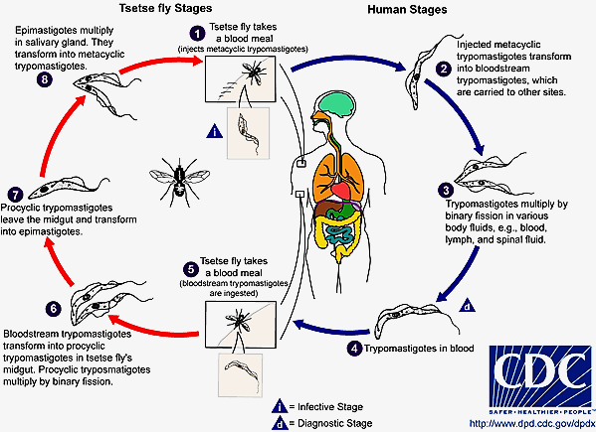

Slide 4
Trypanosoma cruzi
T. cruzi is the causative organism of Chagas’s disease or South American trypanosomiasis.
Habitat
In humans, T. cruzi exists in both amastigote and trypomastigote forms. Amastigotes are the intracellular parasites. They are found in muscular tissue, nervous tissue, and reticuloendothelial system. Trypomastigotes are found in the peripheral blood.
Morphology
Amastigote
Amastigotes are oval bodies measuring 2–4 μm in diameter having a nucleus and kinetoplast. Flagellum is absent Morphologically, it resembles the amastigote of Leishmania spp., hence it is frequently called as leishmanial form.
Multiplication of the parasite occurs in this stage. This form is found in muscles, nerve cells, and reticuloenodothelial systems.

Slide 5
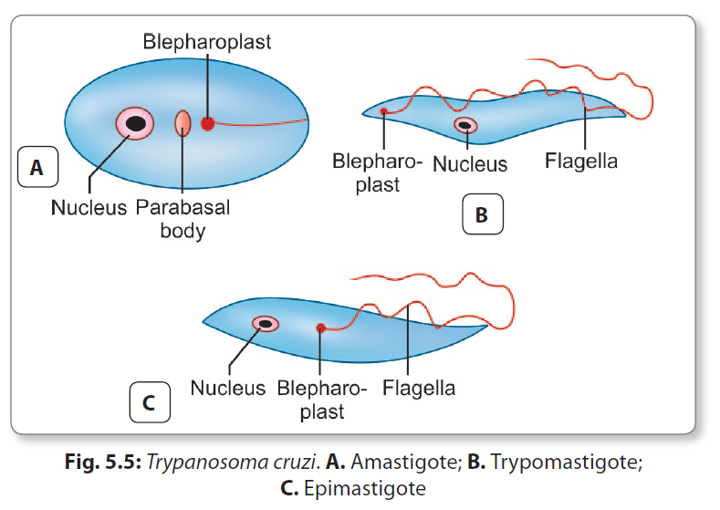
Trypomastigote
Trypomastigotes are nonmultiplying forms found in the peripheral blood of man and other mammalian hosts
In the blood, they appear either as long, thin fl agellates about (20 μm long) or short stumpy form (15 μm long). Posterior end is wedgeshaped.
Epimastigote Form
Epimastigote forms are found in the insect vector, the reduviid bug and in culture also. It has a kinetoplast adjacent to the nucleus. An undulating membrane runs along the anterior half of the parasite. Epimastigotes divide by binary fi ssion in hindgut of the vector.

Slide 6
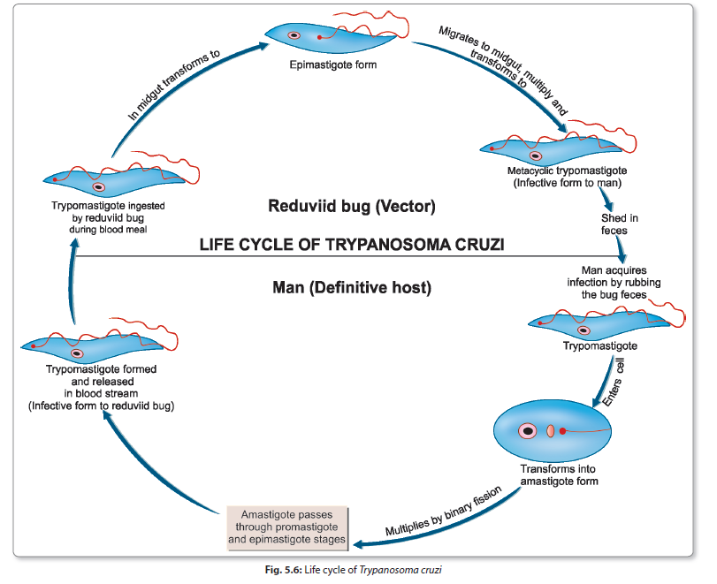
Life Cycle
T. cruzi passes its life cycle in 2 hosts. Defi nitive host: Man Intermediate host (vector): Reduviid bug or triatomine bugs.
Reservoir host: Armadillo, cat, dog, and pigs. Infective form: Metacyclic trypomastigotes forms are the infective forms found in feces of reduviid bugs. The parasite occurs in 3 different but overlapping infection cycles a sylvatic zoonosis in wild animals, peridomestic cycle in dogs, cats, and other domestic animals, and domestic cycle in humans.
The vectors important in human infection are the reduviid bugs adapted to living in human habitations, mainly Triatoma infestans, Rhodnius prolixus.

